Slide 1
Certification by Analysis (CbA) Aeronautical Product Development and Certification (APDC) – an NRC-ARC Program
CASI presentation, 16 & 18 June 2021

Slide 2
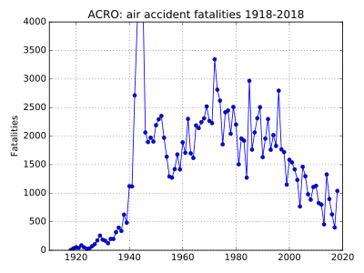
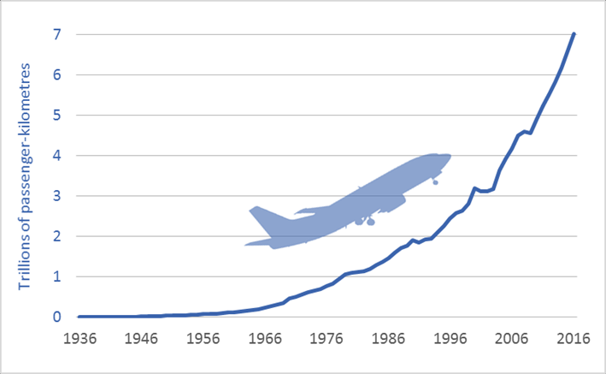
Background
Airworthiness requirements introduced by regulators and ICAO over the years have undeniably made Aviation the safest transportation mode in history.
Unfortunately, these requirements (in their interpretation and application) have rendered the introduction of new aeronautical products perilous for OEMs.
New product launches have resulted in costs and delays that have increased exponentially with no end in sight under the status quo.

Slide 3
Background
Industry, and regulators alike, agree that certification costs and time need to reduced while maintaining safety.
This can only be achieved by accepting certification by alternate Means of Compliance but under what conditions?
Type of Compliance | Means of Compliance | Associated Compliance Documents
Engineering evaluation | MoC0: Compliance statement Reference to Type Design documents Election of methods, factors Definitions | Type Design documents Recorded statements
 | MoC1: Design review | Descriptions Drawings
 | MoC2: Calculation / Analysis | Substantiation reports
 | MoC3: Safety assessment | Safety analysis
Tests (Physical) | MoC4: Laboratory tests | Test programmes Test reports Test interpretation
 | MoC5: Ground tests on related product
 | MoC6: Flight tests
 | MoC8: Simulation
Inspection | MoC7: design inspection / audit | Inspection or audit reports
Equipment qualification | MoC9: Equipment qualification | Note: Equipment qualification is a process which may include all previous means of compliance

Slide 4
The current state of certification
As aerospace technology becomes more advanced, new and stricter certification requirements slow product development, increase testing costs and delay time to market for innovations.

Slide 5
High costs, long delays are the norm
AIRCRAFT | FIRST DELIVERY | DEV. TIME (months) | DEV. COSTS (2017 dollars)
707 | Oct. 1958 | 40 | $1.3B
727 | Feb. 1964 | 48 | $2.3B
A300 | May 1974 | 65 | $7.8B
Concorde | Mid-1976 | 130 | $15.3B
A380 | Oct. 2007 | 84 | $30B (2016)
787 | Oct. 2011 | 100 | $34.9B
A350 | Jan. 2015 | 90 to 120 | $15B (2018)
A-220 (C-series) | July 2016 | 107 | $7B (2016)

Slide 6
Shaping the future of certification
Advanced modelling & simulation (M&S) leading to Virtual testing may one day be powered by artificial intelligence (AI) and machine learning (ML), have brought certification by analysis (CbA) within reach.
CbA stands to reduce reliance on costly, time-consuming physical testing as the only means of compliance. It will speed up time to market for aeronautical products and improve competitiveness — without compromising safety.
The Aeronautical Product Development and Certification (APDC) Program is NRC’s program to realize the potential of CbA in the fields of icing, flight testing, and structures (metals & composites)

Slide 7
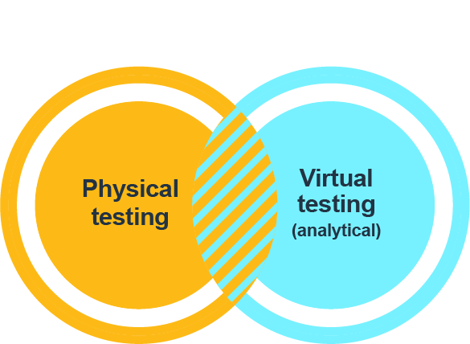
Structural Virtual Testing?
The results of virtual testing need to be verified and validated against real, physical testing results.
In Canada the NRC is in a unique position to cost-effectively provide that verification and validation based on:
More than 40 years’ experience in numerical analysis and modelling/simulation
State-of-the-art facilities across Canada for physical testing

Slide 8
What we’re proposing
If CbA is to be accepted as a means of compliance for certification, aviation authorities need a certain degree of confidence in its accuracy and reliability.
Our proposed APDC Program aims to:
Develop new improved analytical & numerical models (Digital Twin) | Develop Virtual Testing Methods to apply loads on models (Digital Twin) : modelling & simulation | Verification & Validation of the modelling & simulation against physical testing (PT) | Reduce the duration, number and frequency of physical tests using CbA as means of compliance(MoC)

Slide 9
Structures M&S
International Collaboration
EXPECTED OUTCOME
Provide guidelines to introduce M&S as an acceptable MoC in future years

Slide 10
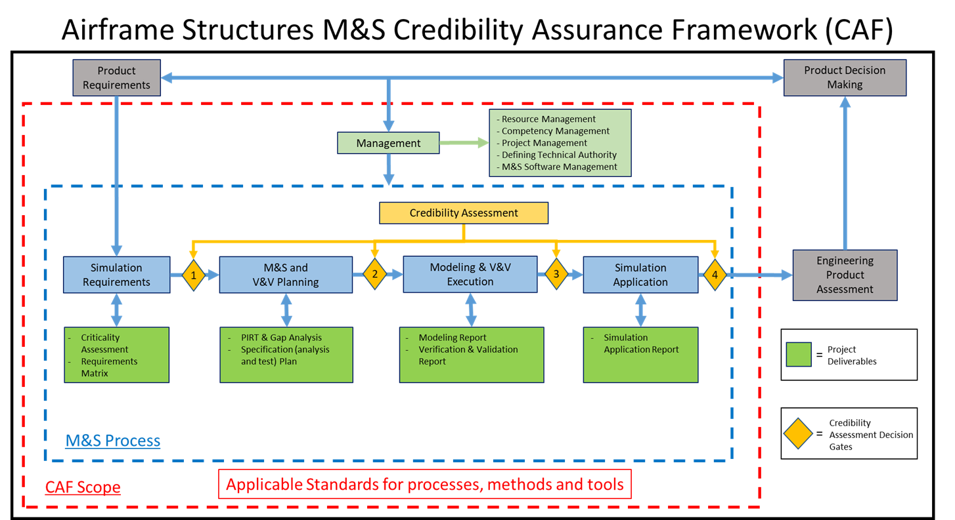
Boeing-Airbus led working group CAF (on-going)
International Collaboration

Slide 11
Structural testing (metals & composites)
FOCUS AREA
EXPECTED OUTCOME
Reduce the number and duration of structural tests
Today, certification requirements are based on coupon, element, component and full-scale tests in both static and fatigue. Advancements in material science and physics-based simulation will enhance the ability of computational modelling tools to complement and even reduce physical testing.

Slide 12
Structural testing
TECHNOLOGY ROADMAP
Year 1
Year 2
Year 4
Year 3
Year 5
Framework Development
Framework development for
integrated multi-physics design and optimization
Physical testing
Coupon, element, component, and full-scale static and fatigue testing technologies for both metals and composites
Modelling & simulation
Material science and physics-based M&S
Industry Community of Interest & Collaboration
International collaboration for V&V process for physical testing versus virtual testing (CSM & ICME)
Integrated Framework Tools
Smarter Testing (ST)
Digital Twin and VT V&V
AC to allow some CbA as partial MoC
M&S guidelines for Structures Cert.
Boeing-Airbus led Working Group for M&S for Airframes
CSM = Computerized structural mechanics
ICME = Integration of materials development and certification
CSM = Computerized structural mechanics
ICME = Integration of materials development and certification
12

Slide 13
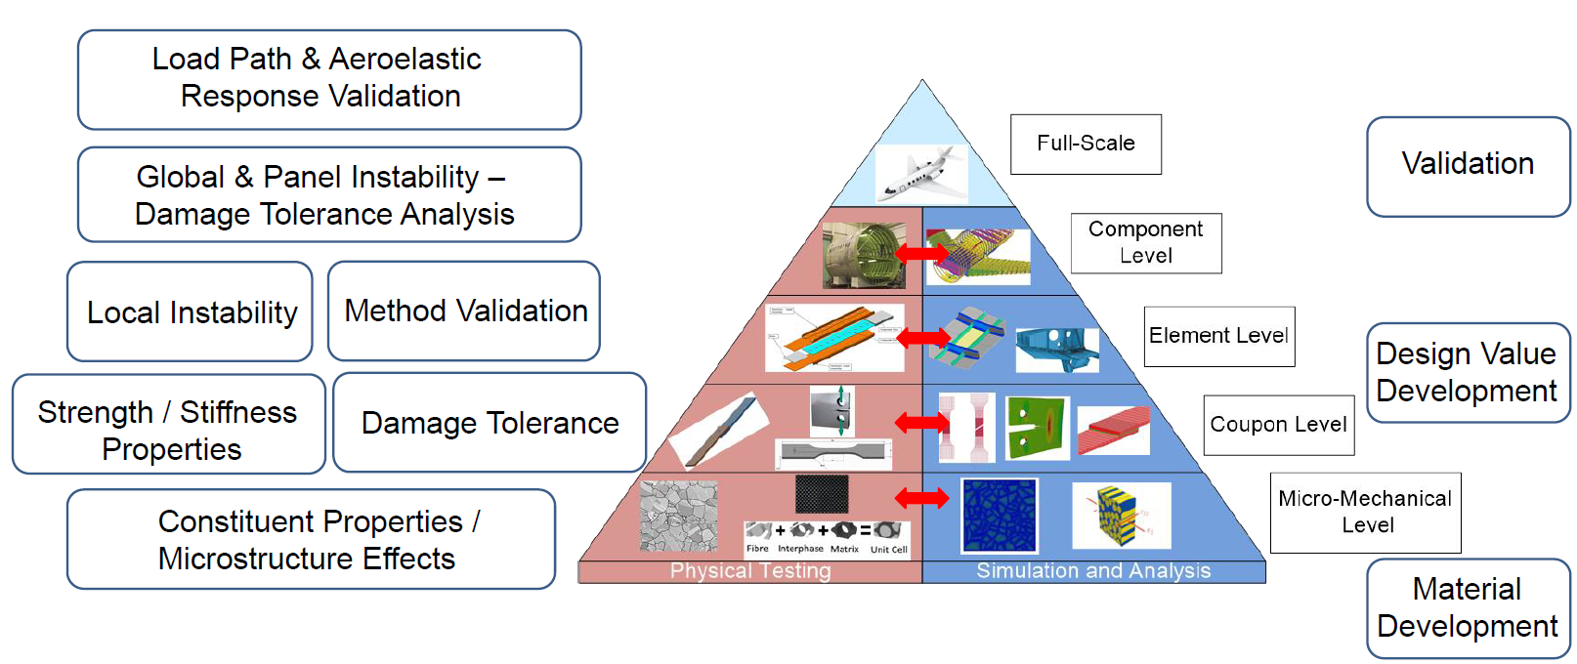
Traditional Airframe Design and Certification

Slide 14
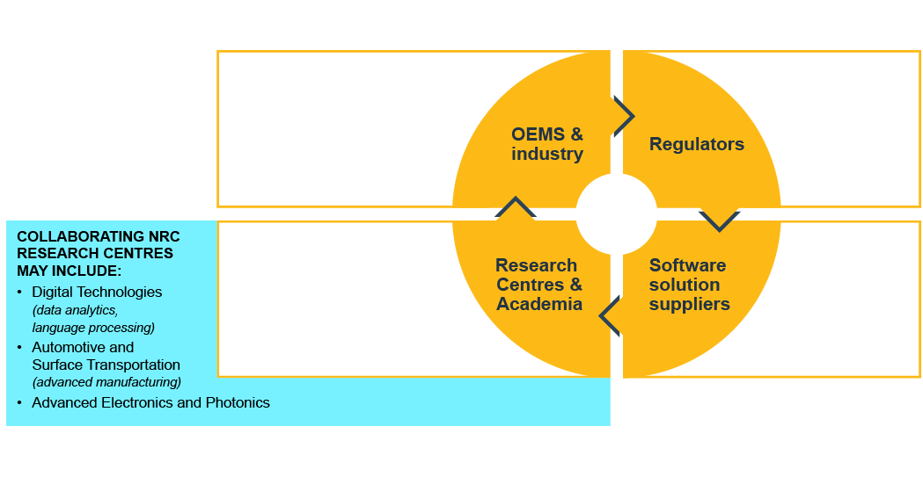
Who’s involved

Slide 15
Thank you!
Dany Paraschivoiu, Program Manager
APDC
dany.paraschivoiu@nrc-cnrc.gc.ca

